Slide 1
Flood Water Depth
Water depth of 6: try to identify inches vs. feet

Slide 2
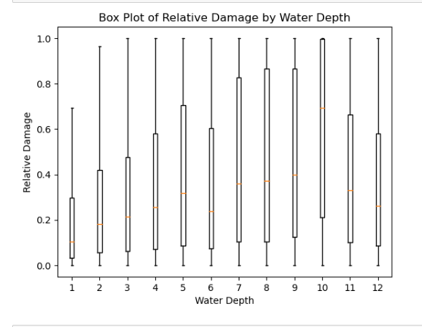
Problem: waterDepth incorrectly stored in inches instead of feet, especially at multiples of 6

Slide 3
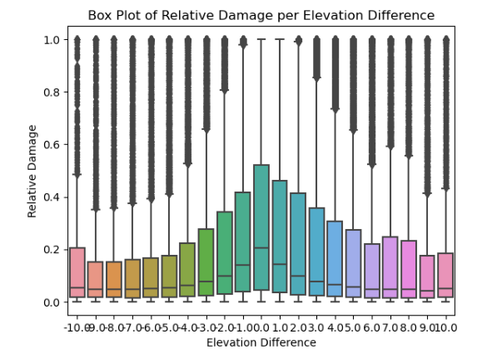
One Strategy: use elevationDifference
Elevation difference records difference between first floor elevation and base flood elevation. Construction is often not allowed beneath base flood, and based on visual, negative values appear to be equivalent to positive values.

Slide 4
Filtering Observations for 6-Foot Flooding
Remove observations with a 6-foot water depth and elevation difference greater than or equal to 6 feet
filtered_df = df[~((df['waterDepth'] == 6) & abs((df['elevationDifference']) >= 6))]
Explanation: Exclude 836 observations with a water depth of 6 feet and an elevation difference of at least 6 feet
Initial mean relativeDamage (waterDepth == 6 and relativeDamage <= 1): 0.3856
Updated mean relativeDamage (after exclusion): 0.3884
0.71% increase of relativeDamage mean at 6 feet
Note: This approach is moderately conservative
Closes 12% of gap between 5 ft and 6 ft relative damage mean
Same but by >= 4 ft
Gets rid of 2833 observations
New mean of .39051
1.2% increase in mean from original
Least conservative
Closes 20% of gap between 5 ft and 6 ft relative damage mean
Further Filtering:
Exclude observations with a water depth of 6 feet, an elevation difference of at least 6 feet, and no event name
filtered_df = df[~((df['waterDepth'] == 6) & abs((df['elevationDifference']) >= 6) & df['floodEvent'].isnull())]
Final mean relativeDamage (6-foot flooding and relativeDamage <=1): .3863
0.16% increase of relativeDamage mean at 6 feet
Gets rid of 117 observations
Note: more conservative, as it requires no event name for exclusion

Slide 5
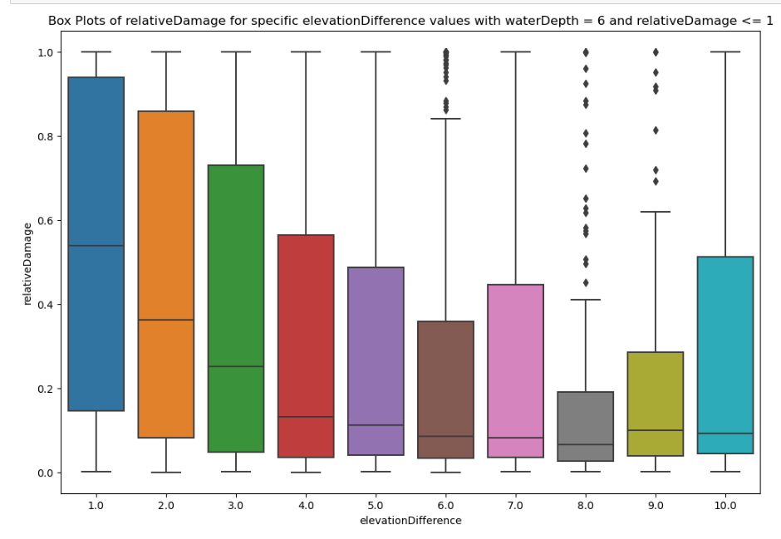
Does this visual indicate more inches at higher elevationDifference per six feet of flooding?

